Slide 1

TASK:-03
Customer Journey Map to:-
Develop a mobile application to track construction site labor movement & ensure the presence of PPE kits within designed safety zones.

Slide 2

Team Members:-Batch -28
1)R. Charitha
24CS003088
2)K. Pavani Priyanka
24CS003087
3) D. Vishali
24CS003085
4) Renu
24CS003086

Slide 3


Overview:-
The goal is to design a mobile application that tracks labor movement on construction sites and ensures that workers are within designated safety zones while wearing the necessary Personal Protective Equipment (PPE) kits. This will help improve safety compliance and streamline tracking.

Slide 4

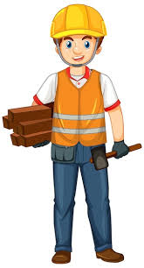
Creating User Persona
Name: Kumar (Construction Worker)
Age: 35
Role: General Laborer
App: Field Wire Construction App
Main Goals:
Complete tasks efficiently while ensuring personal safety.
Stay in safety zones, wear the right PPE, and comply with safety protocols.
Challenges:
Forgetting PPE or zone boundaries due to a busy schedule.
Lack of real-time guidance on where to move and what PPE to wear.

Slide 5

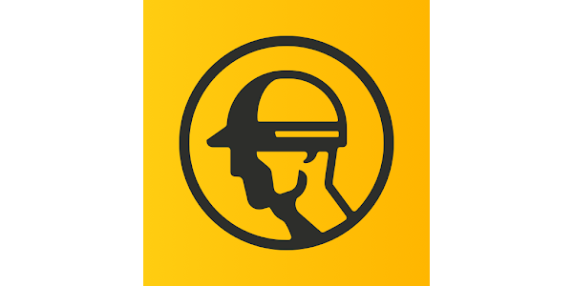
The App used by Kumar is:-
Field wire – Construction App

Slide 6

User flow for Construction worker
Registration:
Kumar installs the app and enters basic information.
PPE Setup:
Kumar selects required PPE items (helmet, gloves, boots) for different work zones.
Safety Zone Setup:
1.Safety Zone Review:
Kumar views the site map with clearly marked zones (e.g., high-risk, medium-risk, low-risk) on his mobile screen.
2.PPE Zone Matching:
The app automatically matches PPE requirements with the zone Kumar is in.

Slide 7
To view the journey map please click on the below link
https://lucid.app/lucidchart/71c4289a-925e-4ac7-b93d-d9ff404d807f/edit?view_items=ynftseE8Lh_v&invitationId=inv_34b0df3e-ff6f-44c1-94f7-6eda0cb08b09

Slide 8

